Slide 1




Distributing Supply Chain Artifacts with OCI & ORAS Artifacts
Steve Lasker
Principal PM Architect
Azure Container Registries
Steve.Lasker@Microsoft.com
@SteveLasker
SteveLasker.blog
github.com/SteveLasker
github.com/SteveLasker/presentations
Registries The Elegance and Evolution
Notes:
Title: Distributing Supply Chain Artifacts with OCI & ORAS Artifacts
URL: https://kccnceu2022.sched.com/event/ytpZ
Abstract:
In a world of continuous supply chain attacks, secure distribution matters more than ever. Your images are now signed, with systems bill of materials (SBOM) and frequent scan results. How will you consume them from public endpoints, promoting them across environments into private network environments where there's no external access? ORAS Artifacts lifts OCI Artifacts to the next level by enabling graphs of artifact relationships to be established. When you archive or delete any given container image, the related artifacts are archived or deleted as well, providing predictable lifecycle management. ORAS Artifacts enable you to build upon the hardened, performant, securely distributed registries you're already using. Come see how registries are evolving, enabling all your cloud-native artifacts to be distributed from the public registries to your private environments, wherever they may be.

Slide 2
Working Agenda
You have a bunch of new supply chain artifacts, where are you going to store them?
Registries as common distribution points – why?
How many storage systems do we need?
What makes registries so good for new types (YASS)
Registries Elegance and Evolution
Elegance
The constructs of a registry
Manifests, Blobs
Lifecycle
OCI Artifacts – generalizing container images
Evolution
ORAS Artifacts for reference types

Slide 3
Agenda
Where/what will you use to store all the different artifacts?
What’s available today?
What will you use next?
Should we build new storage solutions?
Can use existing solutions?
Should we invest in extending existing solutions?

Slide 4
Supply Chain Artifats
Yeah, and ohhh my

Slide 5
Supply Chain Artifacts – What/Where
Software
SBOM
Containers
Packages
Binaries
Virtual Machine Images
Scan Results
Claims
Licenses
gitBOM
Policies
Attestations
Docs
Deployment Templates

Slide 6

Supply Chain Artifacts – What/Where
What is the thing you’re looking to store?
A signature?
A single file (binary, json, yaml)?
A collection of files?
A file(s), with an SBOM?
…which is also signed?
Does each thing have a “version”
How to manage lifecycle?
Notes:
You’re already building the thing, and all the experiences around the thing
What do you do for storage?
Build yet another storage solution (YASS)?
Leverage an existing solution?

Slide 7
Supply Chain Artifacts – What/Where
Where will you store them?
Will you distribute them?
How will you manage their lifecycle?
Notes:
Lets skip where for a second
Will you distribute?
For the things you depend upon (build and run), should you have possession of, at least, the latest version you depend upon?
Should you depend on them from the public internet?
Or, did you import it to your private/controlled environment?

Slide 8
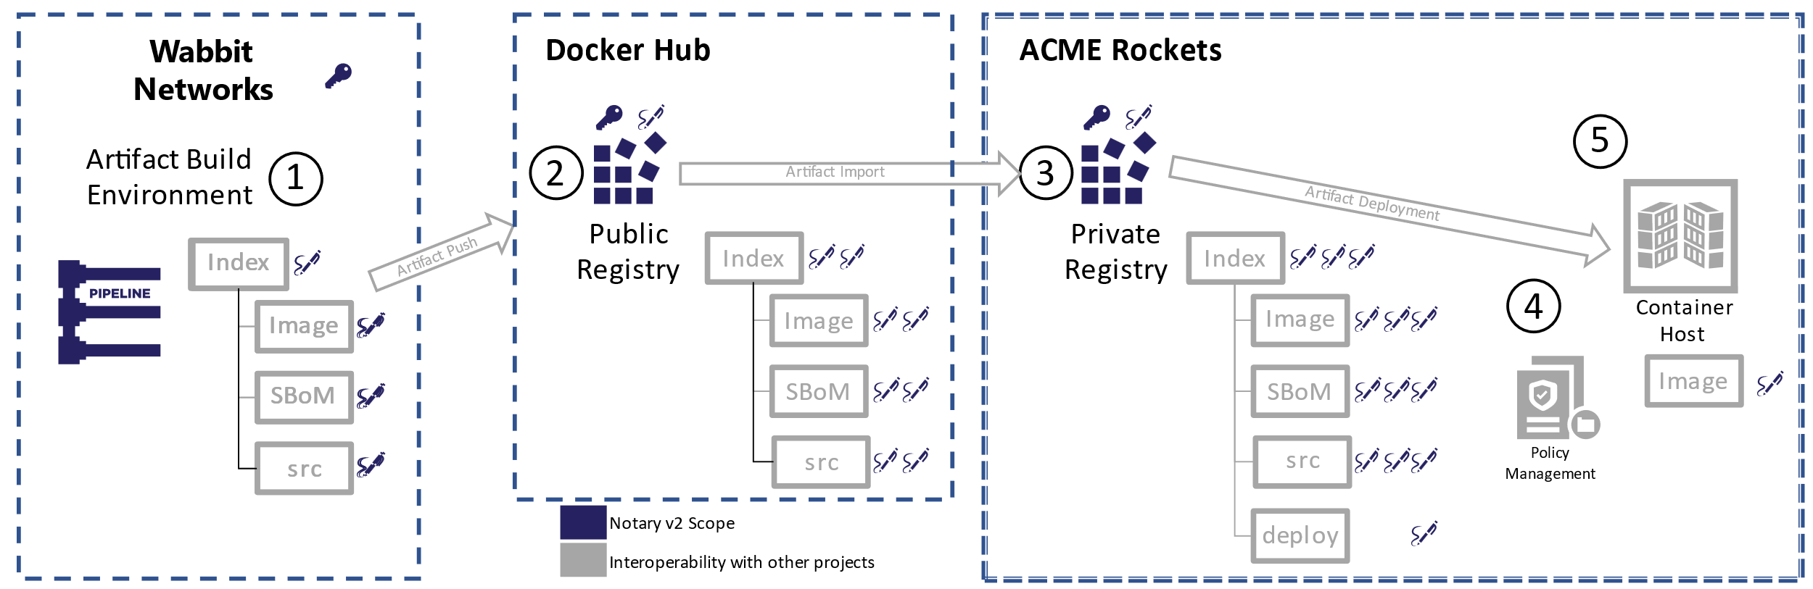
Supply Chain Artifact Distribution
Best Practice:
Own a copy of your dependencies, in an environment you trust
Should the SBOM, Scan Result, Claims travel with …?
Update with claims

Slide 9
Supply Chain Artifact Lifecycle Management
How many builds do you:
produce in a week?
test in a week?
deploy in a week?
For each build:
SBOM
gitBOM
Scan Result
Claims & Attestations
Signatures
Deployment Template

Slide 10
Assets & Liabilities
Non-Deployed Content
How long do you keep it?
Should you keep it?
Is it just a storage problem?
What about newly discovered vulnerabilities?
Deployed Content
Compliance: must keep for 18* months
Deployed binaries, including the associated
SBOMs, Claims, Scan Results
Archived Binaries
What about new vulnerabilities, in deployed content, from 2 months ago?
Do you patch the archived binaries, saved for compliance?
Liabilities
Assets

Slide 11

How to secure access to your artifacts?
What scoping of access will you use?
\Thing1
\Thing2
\Thing3
\TeamA\Thing4
\TeamA\Thing5
\TeamB\Thing6
\TeamC\Thing7
Equal access to all things?
Create, Update, Delete rights?
Listing?
Metadata?
Notes:
You’re already building the thing, and all the experiences around the thing
What do you do for storage?
Build yet another storage solution (YASS)?
Leverage an existing solution?

Slide 12

Production Capabilities
Reliability & Performance: Geo-Replication / Availability Zone Support
Promotion Across Storage Services
Promotion across cloud providers and on-prem
Diagnostics: Logging access, success, failure, denials, performance metrics
Network Security: Virtual Private Networks and Air-Gap Environments
Support: Who, how, what is the SLA?

Slide 13

You have a thing. Where will you store your thing?
YASS?
cache
<-> REST
Thing
Notes:
You’re already building the thing, and all the experiences around the thing
What do you do for storage?
Build yet another storage solution (YASS)?
Leverage an existing solution?

Slide 14
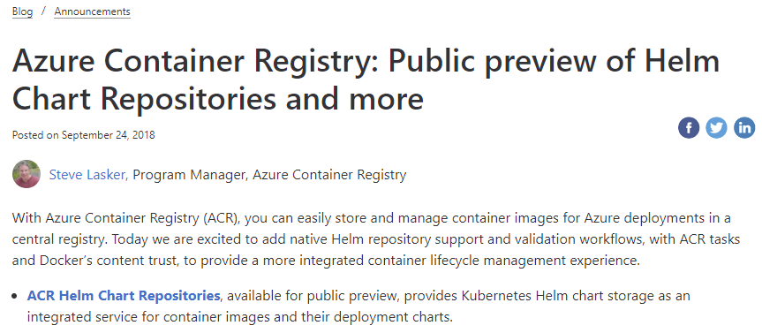

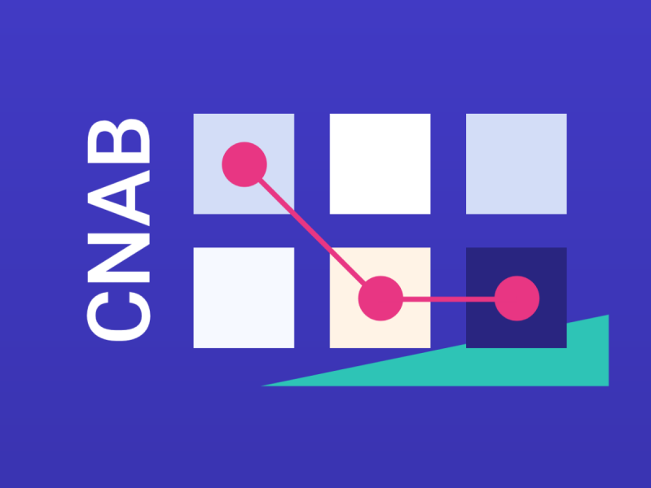

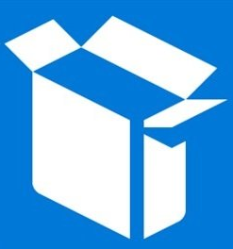


Adding Helm Repos to Azure Container Registry
http://aka.ms/acr/helm-repos
HELM 2
ACR Sprawl…
HELM 3 with OCI Artifacts
$ az acr cnab ...
$ az acr singularity ...
$ az acr msix ...
$ az acr terraform ...
$ az acr opa ...
$ az login
$ az acr helm repo add -r $registry
$ helm package ./wordpress
$ az acr helm push wordpress-5.7.tgz
$ helm fetch $registry/wordpress --version ..
$ helm registry login $registry -u $user -p $pwd
$ helm chart save wordpress/ $registry/wordpress:5.7
$ helm chart push $registry/wordpress:5.7
$ helm chart pull $registry/wordpress:5.7

Slide 15

The Elegance of Registries
OCI Distribution Specification

Slide 16
OCI Distribution Specification
User Perspective:
Image: registry.wabbit-networks.io/monitoring/net-monitor:v1
Registry Endpoint (REST)
Login URL
Namespace
Image
Version
Artifact

Slide 17
Under the covers
What’s under that simple content addressable URL?
The Thing
net-monitor:v1
Manifest
blob1
blob2
blob3
blob…

Slide 18





Docker Pull
Pull:
I want this “thing”, represented by a collection of blobs
docker pull wabbit-networks/net-monitor:v1
Manifests
1. Pull
Manifest:
List of layer ID’s representing the entire thing
Container Host Service
Manifest:
What layers do I already have? ^{(decompressed)}
2. Manifest Returned
net-monitor:v1
3. Delta of Blob Requests
net-monitor:v1.1
net-scan:v12
Image Cache
IMAGE ID REPOSITORY TAG SIZE
694950fbcb3f wabbitnetworks/net-monitor v1 1.2B
4. Blob URLs Returned
Layers Please:
List of compressed blob URLs
blobs
5. Blob Request
cf4ecb49238476635f551fe11987ae4c3
e41864ee12411ff073f0a58417cf7e160
85bef57c324acc96f7067488d35b7e3c1
Layer Cache
LAYER ID
1d57d886885835cbc52c2d85fe0ce008f
6. Blobs Returned
f78a85a7da099d7494a5166a28e72a642
sha256:cf4ecb49238476635f551fe11987ae4c3
da3343b41a78a0bcd4926d605b6fe37ba
sha256:e41864ee12411ff073f0a58417cf7e160
c935edcb03a0660b347d2fbf6542ee068

Slide 19
Elegance - Manifest
{
"mediaType": "application/vnd.cncf.oras.artifact.manifest.v1+json",
"artifactType": "application/vnd.oci.image.manifest.v1+json",
"blobs": [
{
"mediaType": "application/vnd.oci.image.config.v1+json",
"digest": "sha256:e752324f….d0031cf06cdb3c7ad1625dcd1b399",
"size": 7097
},
{
"mediaType": "application/vnd.oci.image.layer.v1.tar+gzip",
"digest": "sha256:83c5cfdaa5…5d74de847a7bdd968555b8f2c558dac0e",
"size": 25851449
},
{
"mediaType": "application/vnd.oci.image.layer.v1.tar+gzip",
"digest": "sha256:7445693bd43e8246a8c166233392b33143f7f5e396c480f74538e5738fb6bd6e",
"size": 226
}
]
}
net-monitor:v1 aka net-monitor@sha256:abc123s1212...9a81b
{
"schemaVersion": 2,
"mediaType": "application/vnd.oci.image.manifest.v1+json",
"config": {
"mediaType": "application/vnd.oci.image.config.v1+json",
"digest": "sha256:e752324f6804d5d…d1625dcd1b399",
"size": 7097
},
"layers": [
{
"mediaType": "application/vnd.oci.image.layer.v1.tar+gzip",
"digest": "sha256:83c5cfdaa5385ea6…968555b8f2c558dac0e",
"size": 25851449
},
{
"mediaType": "application/vnd.oci.image.layer.v1.tar+gzip",
"digest": "sha256:7445693bd43e…96c480f74538e5738fb6bd6e",
"size": 226
} ,
"annotations": {
"example.sbom.author": "wabbit-networks.io"
}
]
}
Manifests provide:
Collections of Blobs (0|1 or more)
Descriptor
Type
Hash
Size (checksum)
Metadata through Annotations
{
"mediaType": "application/vnd.cncf.oras.artifact.manifest.v1+json",
"artifactType": "sbom/example",
"blobs": [
{
"mediaType": "application/tar",
"digest": "sha256:9834876dcfb05cb167a5c…8f2f9d09af107ee8f0",
"size": 32654
}
],
"subject": {
"mediaType": "application/vnd.oci.image.manifest.v1+json",
"digest": "sha256:73c803930ea3b…51fe7b00369da519a3c333",
"size": 16724
},
"annotations": {
"example.sbom.author": "wabbit-networks.io"
}
}

Slide 20
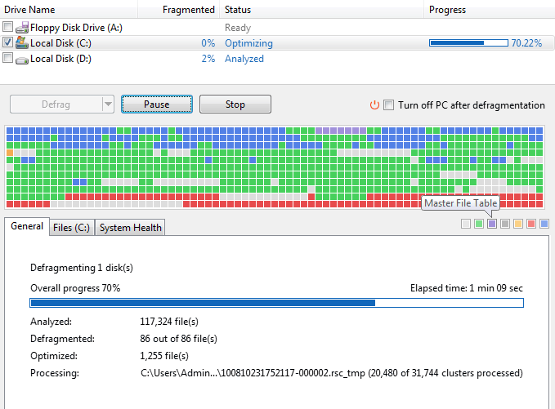
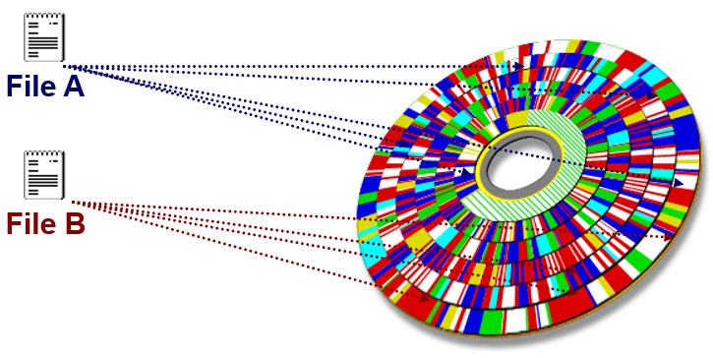
Files
foo.txt

Slide 21
Elegance - Manifest
Manifest = An Artifact (a container image is a type of artifact)
Blobs = The content of the thing, segmented into 1 or more blobs
Several Manifest Types
Docker Manifest application/vnd.docker.distribution.manifest.v2+json
OCI Image Manifest application/vnd.oci.image.manifest.v1+json
Docker Manifest List application/vnd.docker.distribution.manifest.list.v2+json
OCI Index application/vnd.oci.image.index.v1+json
… but wait, there’s more

Slide 22
Tags
put manifest
{
"mediaType": " application/vnd.oci.image.manifest.v1+json",
"digest": " sha256:83c5cfdaa5385ea6…968555b8f2c558dac0e",
"size": 12454
}
net-monitor:v1
{
"mediaType": " application/vnd.oci.image.manifest.v1+json",
"digest": " sha256: e752324f6804d5d…d1625dcd1b399",
"size": 12454
}

Slide 23
Elegance of Distribution
Manifests = things
Blobs = content of the things
Blobs can/should be de-duped¹
Secured in namespaces
All content has unique identifiers (digests aka descriptors)
Tags = pointers to a unique manifest descriptor
Artifacts can be payloads from KB to GB and beyond
De-duping has security implications. Typically, de-duping within a controlled security boundary.

Slide 24
Kinda Useful
Was there anything really unique to container images?

Slide 25
Running A Storage Thing
VNET & Firewall Rules?
Documentation?
Authentication
What will you use?
Will it integrate with the rest of “the platform”
Security
How do you prevent hacks, DOS attacks, abuse?
Costs
Will you justify the costs to run the YASS?
Will you charge, offer for free- your YASS?
Multiple clouds?
Will other cloud vendors host this YASS for you?
Compliance
cache
<-> REST
Regional Replication?
Signing?

Slide 26
Running A Storage Service
VNET & Firewall Rules?
Documentation?
Authentication
What will you use?
Will it integrate with the rest of “the platform”
Security
How do you prevent hacks, DOS attacks, abuse?
Costs
Will you justify the costs to run the YASS?
Will you charge, offer for free- your YASS?
Multiple clouds?
Will other cloud vendors host this YASS for you?
Compliance
<-> REST
cache
Regional Replication?
Signing?

Slide 27
Registries & Reference Types
Registries are ubiquitous across all cloud providers
Cloud, On-Prem, IoT
Support performance, reliability, security capabilities from dev→prod
Users want fewer services to run, configure & maintain
Artifact authors want to focus on their thing
Does the SPDX, CycloneDX, Foo Community want to design, spec, build, operate Yet Another Storage Service?

Slide 28
Artifact: Reference Type Principals
Multiple artifacts exist, and none should have to create YASS
Persisted alongside the subject artifact
Solves the discovery problem & network isolated/air-gapped environments
Reference Types artifacts can be copied with the target artifact
Associated with, but separable from the target artifact
Solves the trojan horse validation challenge
Target artifact must not change when adding new artifacts
docker pull mcr.microsoft.com/dotnet/runtime:5.0
docker pull mcr.microsoft.com/dotnet/runtime@sha256:ca9c27f79cfc669d74befcd93f
Helm chart references
Kubedeploy.yaml references
1- YASS- Yet Another Storage Service

Slide 29
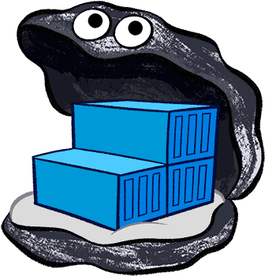
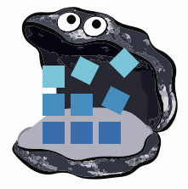











YASS
Container Registries
→ Artifact Registries
!
Y
Yet
Another
Storage
Solution
A
S
S

Slide 30
Registries & Reference Types
Registries are ubiquitous across all cloud providers
Cloud, On-Prem, IoT
Support performance, reliability, security capabilities from dev→prod
Users want fewer services to run, configure & maintain
Artifact authors want to focus on their thing
Does the SPDX, CycloneDX, Foo Community want to design, spec, build, operate Yet Another Storage Service?

Slide 31
Artifact: Reference Type Principals
Multiple artifacts exist, and none should have to create YASS
Persisted alongside the subject artifact
Solves the discovery problem & network isolated/air-gapped environments
Reference Types artifacts can be copied with the target artifact
Associated with, but separable from the target artifact
Solves the trojan horse validation challenge
Target artifact must not change when adding new artifacts
docker pull mcr.microsoft.com/dotnet/runtime:5.0
docker pull mcr.microsoft.com/dotnet/runtime@sha256:ca9c27f79cfc669d74befcd93f
Helm chart references
Kubedeploy.yaml references
1- YASS- Yet Another Storage Service

Slide 32
Promoting Artifacts
How to promote a graph of artifacts?
Several tools were used to create various artifacts
Container Build Tools (Docker)
SBoM Creation (CycloneDX, SPDX)
Image Scan Results (Aqua, Palo Alto, Snyk)
Signatures (Notary, Cosign)
Should each tool be used to promote the graph?

Slide 33


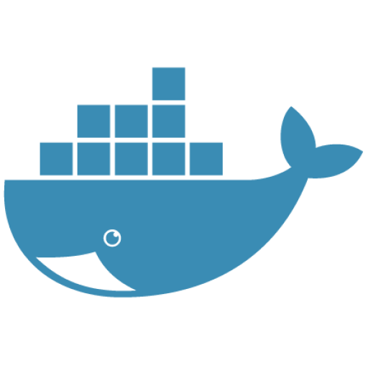

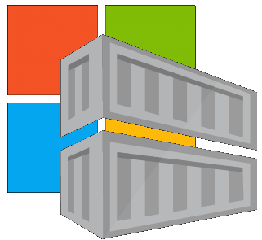

Location Independence
Which Public Registry, for which content?
docker hub
ecr public
your registry
mcr
github

Slide 34
Demo
Annotations

Slide 35
Adding Context To Signatures
What does the signature mean?
Signer “Approved The Document”
What is the definition of approved? (Build, Scanned, Applicable for ___)
Claims as Annotations?
Name/value pairs
{
"mediaType": "application/vnd.cncf.oras.artifact.manifest.v1+json",
"artifactType": "sbom/example",
"blobs": [
{
"mediaType": "application/tar",
"digest": "sha256:9834876….09af107ee8f0",
"size": 32654
}
],
"subject": {
"mediaType": "application/vnd.oci.image.manifest.v1+json",
"digest": "sha256:73c803….00369da3c333",
"size": 16724
},
"annotations": {
"io.acme-rockets.policy.scanned": "policy12",
"io.acme-rockets.policy.base-images": “approved",
"io.cncf.oras.artifact.created": “2022-04-20T08:53:09.42 "
}
}
io.acme-rockets.policy.base-images=approved

